Slide 1
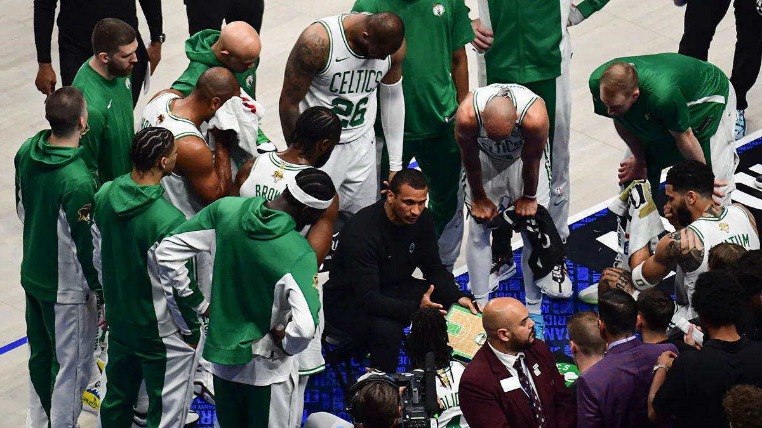
HoopScout
Multi-agent pre-game report generation system

Slide 2

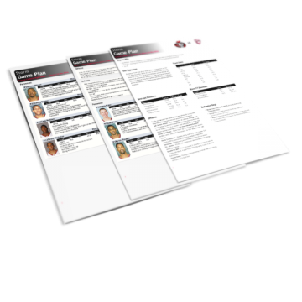
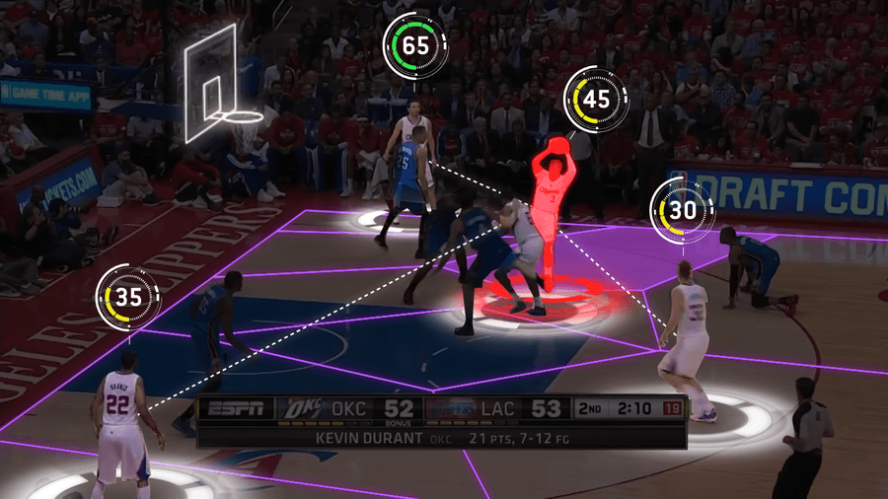
Goal & Motivation
Motivation
NBA coaches and players need to understand opposing teams’ and players’ performance to develop strategies accordingly
NBA games happen daily, leaving limited preparation time
Goal
Develop a solution to transform information and game stats into clear, structured pre-game reports
Notes:
(35s)
In competitive basketball, understanding the performance of opposing teams and players is important to tailor strategies accordingly.
with the NBA’s packed schedule, games happen almost daily, and the amount of available data is constantly updating. This means integrating and processing data has become an overwhelming task
Hence we aim to generate pre-game player report based on their stats over the last few games

Slide 3
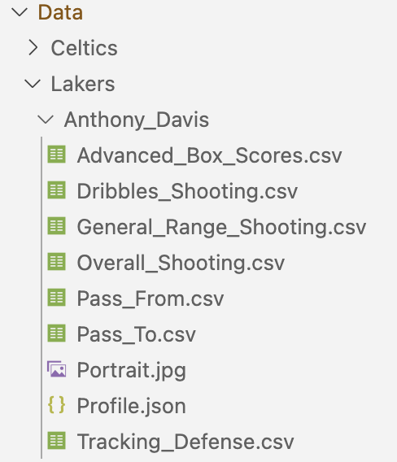
Data and Data Processing
Collected from NBA.com/stats
Each player - 9 files
1 json file of player profile
7 csv files
Scores
Shots, passes, defense
Player portrait
Notes:
slide 3~8: about 1min 15sec
We sourced our data from stats section of NBA.com… //as it’s the official website for detailed and up-to-date statistics suitable for our task.
For each player, we collected and classified data into 9 files, including 1 json file of the player’s profile, 7 csv files with different aspects of the player’s performance (//in the latest matches such as scores, shooting, passing, and defense).
A player portrait picture is also used to complete the scouting report.
In total about 20 sets of data were collected to develop and tune our system.

Slide 4
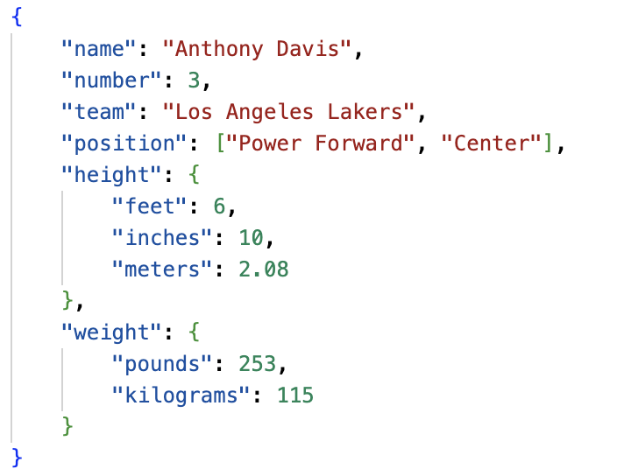
Player Profile (json)
Notes:
Here is what the data look like…
Player profile contains essential information like player’s position, height and weight

Slide 5
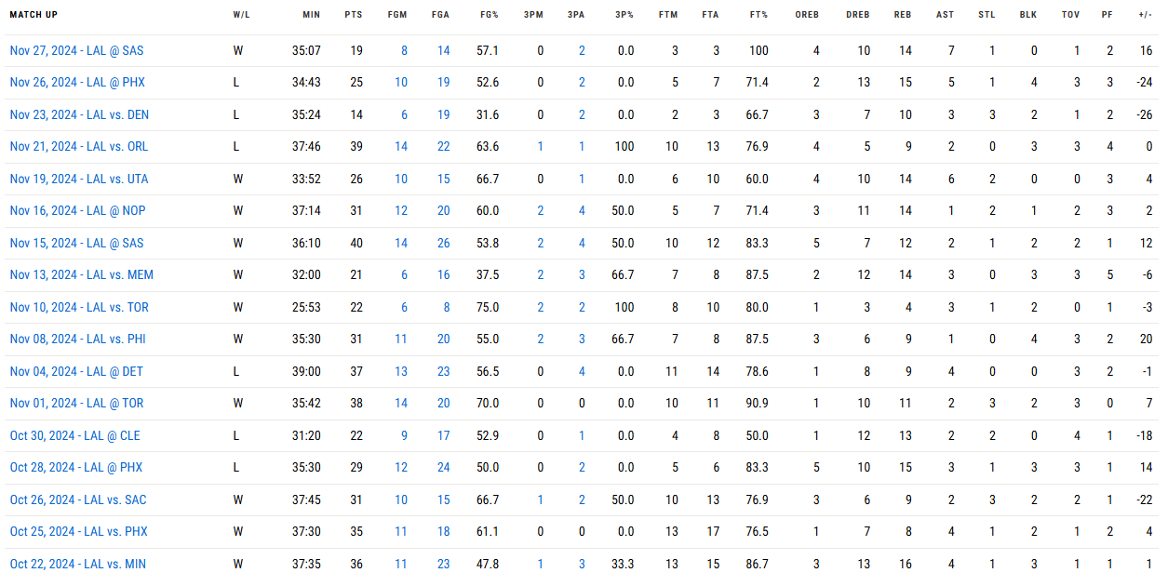
Advanced Box Scores
Detailed metrics of recent matchups
Points (PTS), Rebounds (REB), Assists (AST), etc.
Notes:
Advanced Box Scores capture detailed metrics like points, rebounds, assists // in recent matchups

Slide 6
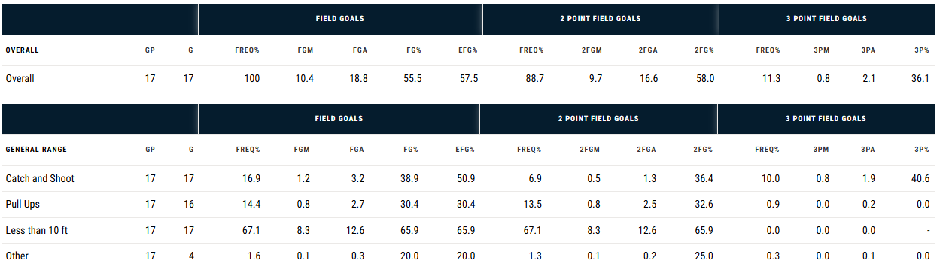
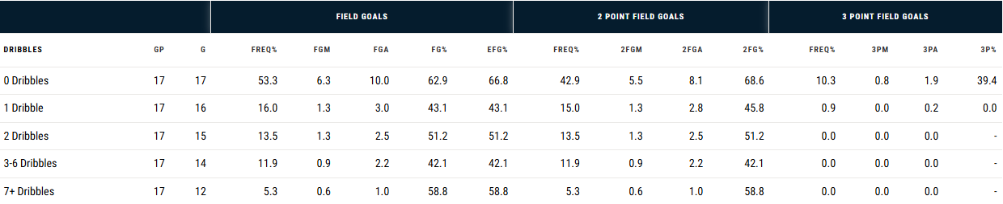
Shooting Stats
Overall, different ranges, dribbles
Field goal frequency (FREQ%), 2-point, 3-point attempted (FGA) and made (FGM), etc.
Notes:
Shooting stats break down player’s shooting performance across different ranges. // This includes stats like Field goal frequency, number of 2-point and 3-point attempted and made.

Slide 7
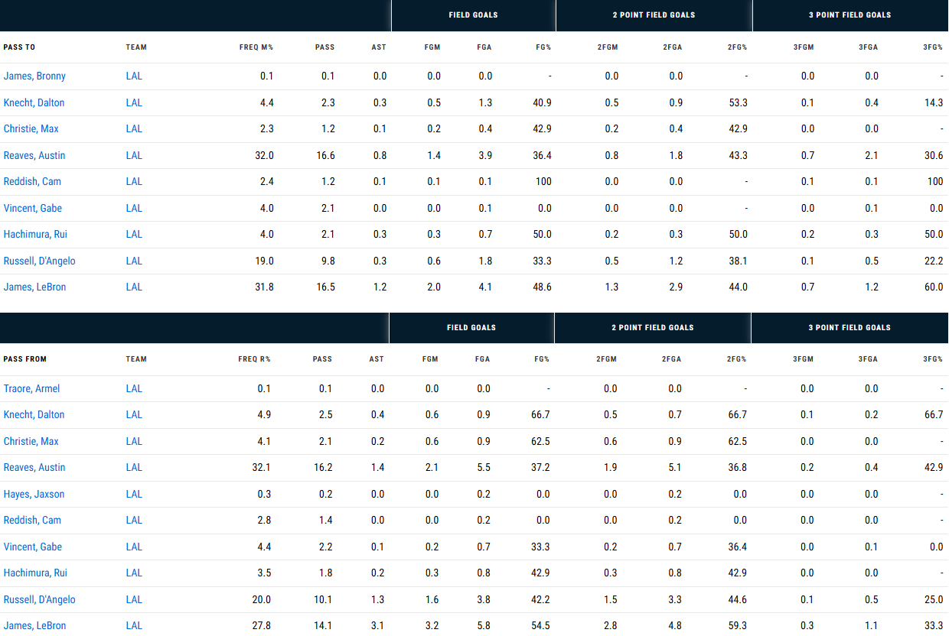
Passing Stats
Player’s stats of Pass-To and Pass-From different teammates
Notes:
Passing stats demonstrate the player’s teamwork pattern // including both pass-to and pass-from stats

Slide 8
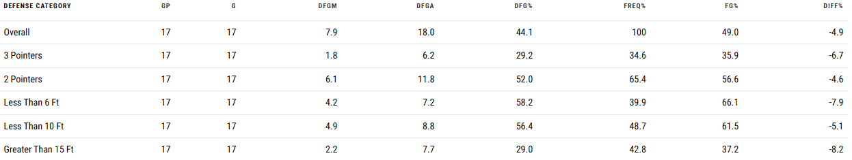
Defense Stats
Defended field goals (DFGM), frequency (FREQ%), percentage (FG%), etc.
Notes:
And defense stats show the player’s guarding performance

Slide 9

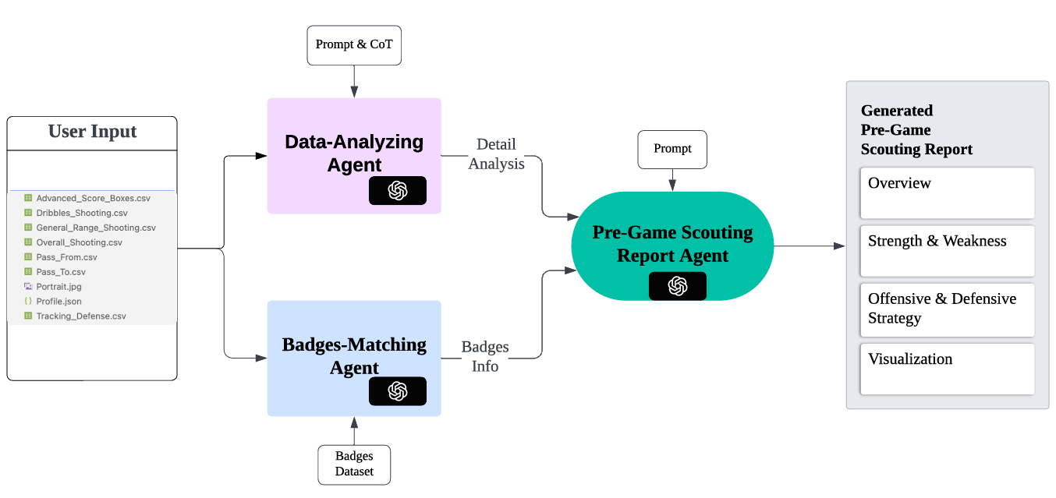
System Architecture
Notes:
The system employs a multi-agent architecture, and integrated into a Gradio interface to provide users with an intuitive platform for interaction.

Slide 10
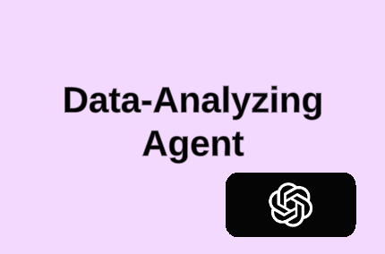
Analyzing given player’s stats and profile.
Finding useful and insightful pattern and information.
Prompt Engineering:
Role Prompting
Emotion Prompting
CoT
Few Shots
Generate an in-depth and detail player analysis.
Notes:
By Leveraging prompt engineering techniques such as role prompting, emotion prompting, CoT, few shots, this agent dentifies insightful patterns and actionable information from the provided data. Generates a detailed and in-depth player analysis.

Slide 11
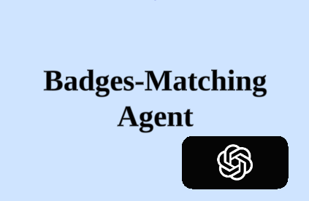
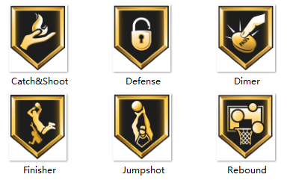
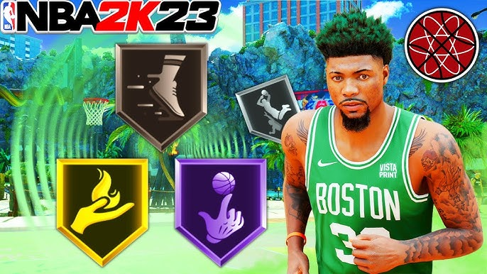
Mimic a video game badge system.
Based on player’s stats, check his eligibility for each badge.
Total 6 types of badges.
Direct insight for viewers.
Defense Badge
DIFF% ≤ -5%
(BLK ≥ 1.5 | STL ≥ 1.5)
Inside Scorer Badge
FG% Less Than 10 Feet ≥ 60
Freq Less Than 10 Feet ≥ 50%
PPG in paint ≥ 10 PPG
FTA ≥ 5 PPG ≥ 15
…
…
Notes:
Additionally, the badge agent mimics a basketball video game badging system. Assigns up to six badges to player, each symbolizing unique skills, tendencies, and attributes of the player. Hence simply looking at them, viewers can gain direct insight and understanding about player type and style..

Slide 12
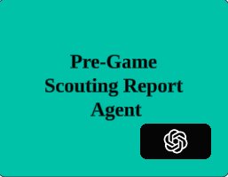
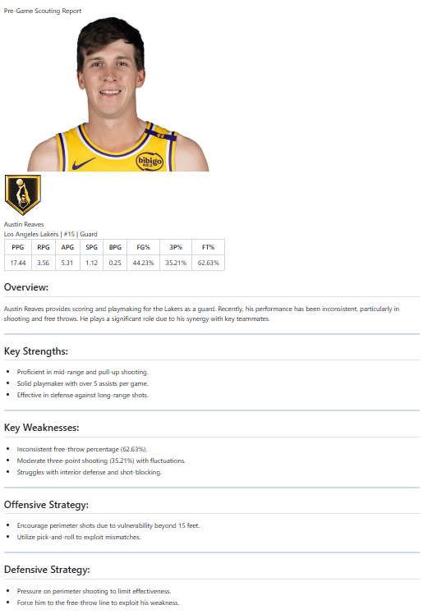
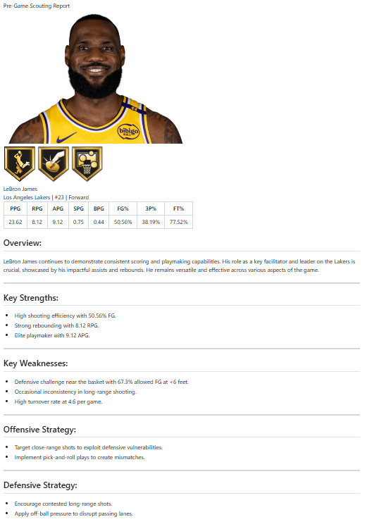
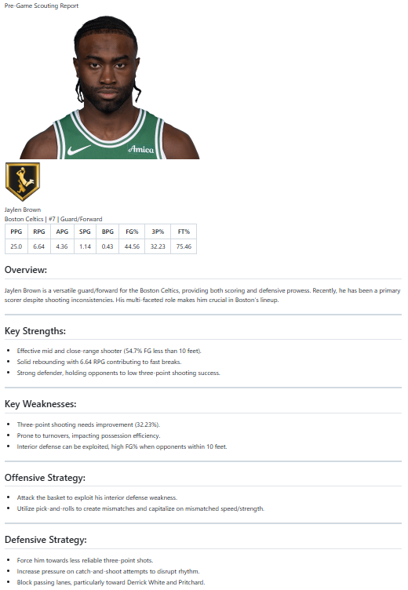
Generated
Pre-Game
Scouting Report
Notes:
Our final agent restructures and simplifies the gathered information, a final report is ready for use

Slide 13
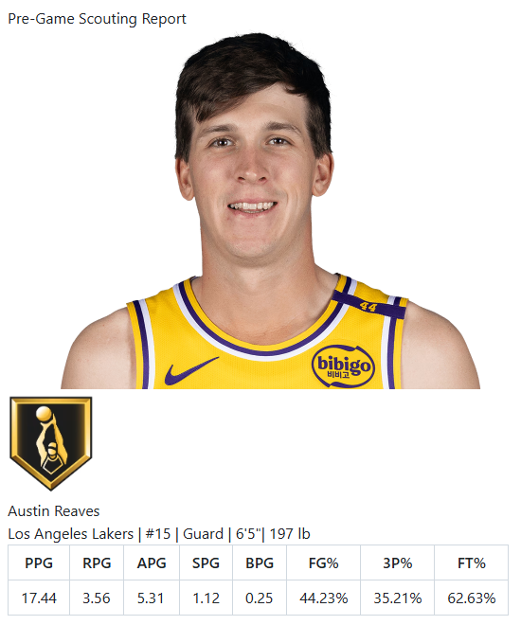
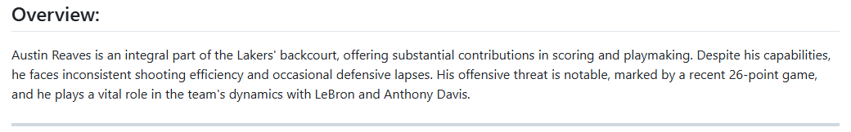
A closer-look
Player’s profile
Overview:
A brief summary of the player's recent trends, performance, and role in the team.
Notes:
Here a closer look at our generated report, including player’s portrait, bages, and a brief summary of the player’s recent trends and performance over the last few games

Slide 14
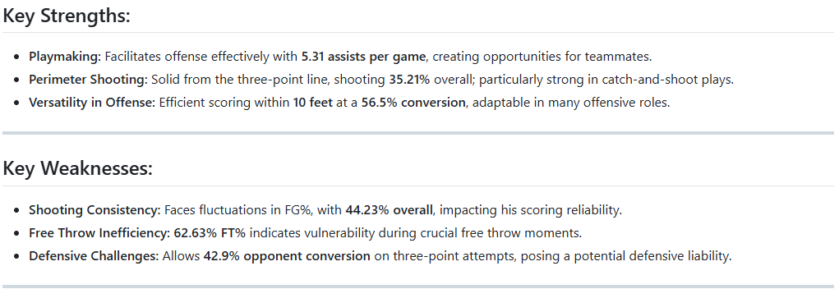
Key Strengths:
Player’s most impactful strength, such as scoring, defense, playmaking, etc.
Key Weaknesses:
Player’s vulnerabilities.
Notes:
The report showing PLayer’s key strength and their vulnerabilities are included

Slide 15
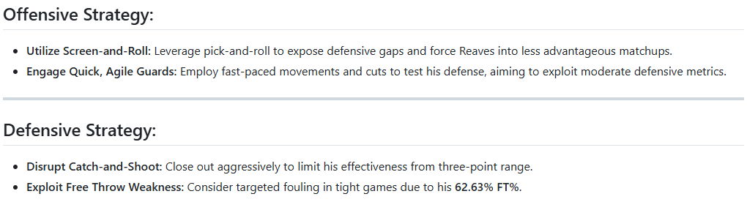
Offensive Strategy:
The most effective way to attack this player when he is on defence.
Defensive Strategy:
How to guard this player and limit his strength.
Notes:
And offensive and defensive strategy against the player are created.

Slide 16
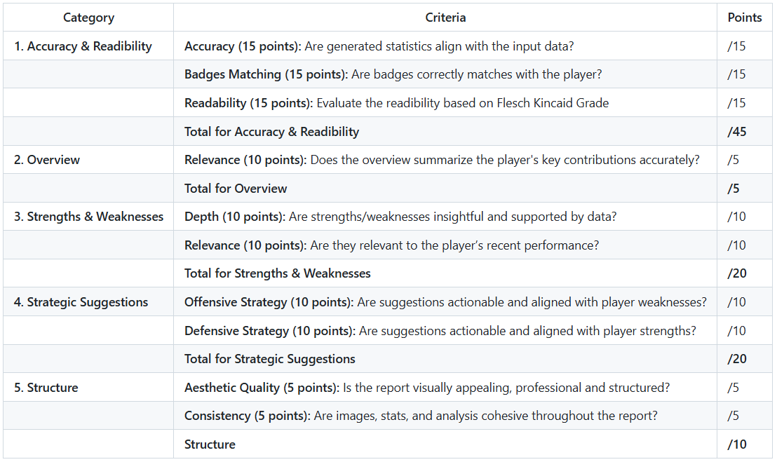
Report Grading Rubric
Notes:
Our system's performance is evaluated using a detailed rubric that captures both quantitative and qualitative aspects, as demonstrated here
（Here shows the rubric we used for evaluating our model that captures both quantitative and qualitative aspects. ）

Slide 17

Quantitative Results
Automate Grader Metrics
Rule-based badge-matching
Flesch-Kincaid readability scoring
Human Evaluation
Contextual relevance
Quality of player insights (e.g., strength, weakness)
Average Score for 18 generated Pre-Game Reports
0-shot prompting : 72.4
1-shot prompting: 88.2
Badges Matching Challenges
LLM has difficulty with numerical operations
Incorrectly determine player eligibility for badges
Notes:
(60s: slide 16- slide 17)
Certain aspects, like badge matching and readability, are automated. Badge accuracy is determined using a set of rules, while readability is evaluated with the Flesh-Kincaid Grade, which is a numerical scale indicating the education level needed to understand the text. The remaining categories, ….. are graded by people with extensive knowledge of NBA players.
Using zero-shot prompting, the average score across 18 reports was 72.4, while one-shot prompting improved the performance to 88.2
However, the badge-matching scores were relatively low, highlighting that the LLM may struggle with numerical operations
（The evaluation of our system's performance was conducted through a combination of automated and human review methods
Certain metrics, such as badge matching and readability, were evaluated through automated processes. Badge matching was assessed using a rule-based approach that checks alignment with predefined scouting criteria. Readability was quantified using the Flesch-Kincaid Grade Level.
Other aspects, such as contextual relevance and player insight quality, we relied on human reviewers. (These reviewers were individuals with extensive experience and knowledge of NBA scouting and player analysis)

Slide 18
Highlights from a Typical Report
Reasonable & Supported by Stats
“56.5% conversion within 10 feet, demonstrating adaptability in offensive roles.”
“Opponent 42.9% conversion on three-point attempts signals a defensive liability.”
Insightful from Data Analysis
“His offensive threat is notable, marked by a recent 26-point game, and he plays a vital role in the team's dynamics with LeBron and Anthony Davis.”
“Close out aggressively to limit his effectiveness from three-point range.”
Notes:
(70s: slide 16 - slide 18)
This slide provides examples of some highlight phrases extracted from a typical report generated for Austin Reaves
The claims in the report are both reasonable and supported by the provided statistics. ( For instance, the report highlights Reaves' 56.5% conversion rate within 10 feet, underscoring his offensive versatility. On the defensive side, his vulnerability is clear, with opponents converting 42.9% of three-point attempts when he's guarding, making him a potential defensive liability.)
And beyond the numbers, the report effectively extracts patterns and insights (It notes his recent 26-point game, emphasizing his critical role alongside LeBron James and Anthony Davis. To counter his offensive threat, the report suggests aggressive close-outs to disrupt his three-point effectiveness.)

Slide 19
Overview
Visualization
Clean format with portrait and badge icons
Structure
Clear sections: Overview, Strengths, Weakness Strategies
Use of bullet points enhances readability
Content Quality
Statistics and analysis are up-to-date and relevant
Direct correlation between strength/weakness and statistics
Strategies can be too generic
Lack of comparison
Notes:
In this slide, we provide an overview of the final product from different aspects.
From the visualization, our pre-game report shows a clean format with portrait image and badge icons.
In terms of structure, we have organized sections with bullet points to enhance readability
Finally, our contents are up-to-data and closely relevant to the player.
The statistics directly reflect the player’s strength and weakness
However, the analysis on offensive and defensive strategies can be too generic, more details and steps should be included
It’s also a good idea to add a comparison with average players.

Slide 20
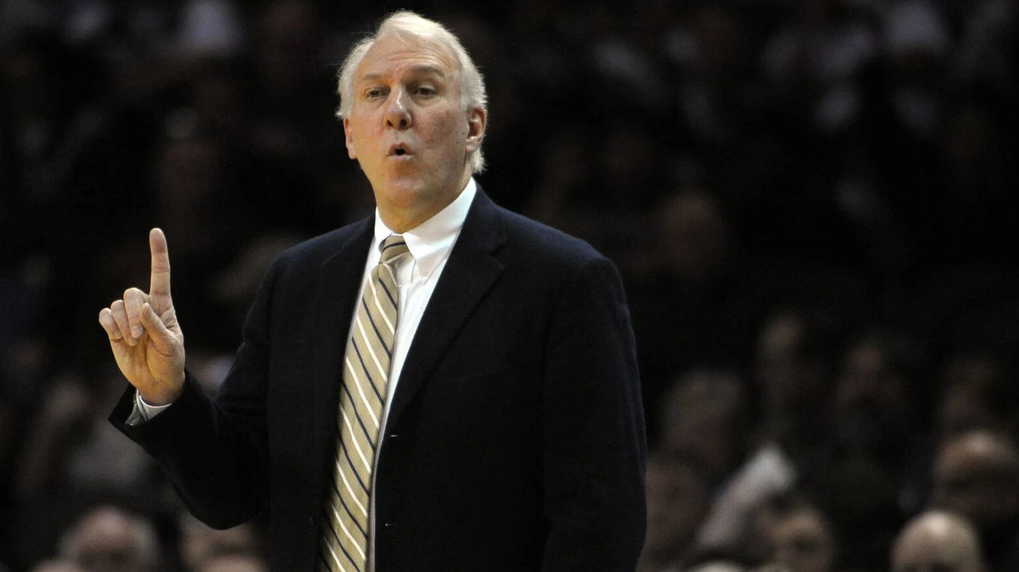
Discussion
In a similar project
Reduce redundancy, increase complexity of a multi-agent system
Increase level of details in prompts
Reduce tasks dealing with complex number operations
Notes:
Currently, we can generate results with less details using a single prompt.
In a similar project, we will try to explore the potential of multi-agent system
by reducing redundancy between agents and increase problem complexity.
We can also improve the agents to analyze the NBA statistics in a professional way.
For similar projects, We will try to increase level of details in prompts
We also found GPT is not good at complex number operations.
Reducing or skipping complex number operations is also crucial.

Slide 21
References
Yardbarker. (n.d.). NBA head coaches with the most wins. Retrieved December 2, 2024, from https://www.yardbarker.com/nba/articles/nba_head_coaches_with_the_most_wins_100523/s1__38910514
Vautour, M. (2023, May). Celtics fail to deliver on Game 7 hype, leave business unfinished. MassLive. Retrieved December 2, 2024, from https://www.masslive.com/celtics/2023/05/celtics-fail-to-deliver-on-game-7-hype-leave-business-unfinished-vautour.html
FastModel Sports. (n.d.). Coaching software: FastScout report builder. Retrieved December 2, 2024, from https://team.fastmodelsports.com/coaching-softwarefastscout-report-builde/
Reddit. (2013). All 40 badges in NBA 2K25 [Online forum post]. Retrieved December 2, 2024, from https://www.reddit.com/r/NBA2k/comments/1en8fuk/all_40_badges_in_nba2k25/

Slide 22
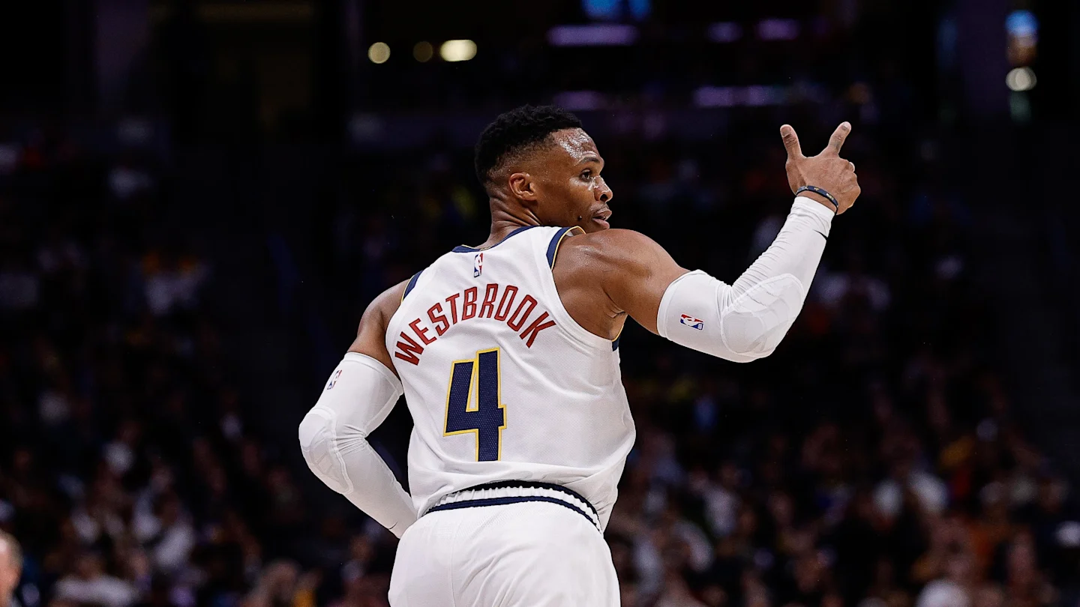
Thank you!

